Slide 1


Slide 2
Where to use OneDrive?
What is OneDrive?
OneDrive is a cloud-based solution that provides a place in the cloud where you can store, share, and sync your work files. You can update and share your files from your mobile device and can even work on Office documents with others at the same time.
Employees get unlimited space, while non-employees get 1 TB each.
Backing up all your files (Highly Restricted files approved).
Sending large files internally and externally.
Collaborating on one-pagers and scorecards as OneDrive enables simultaneous editing.

Slide 3

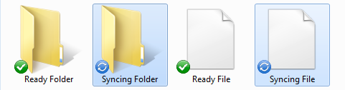
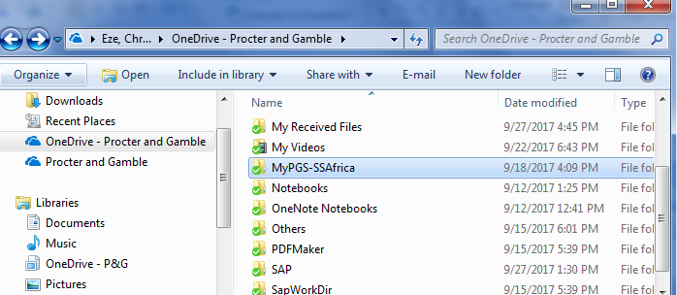
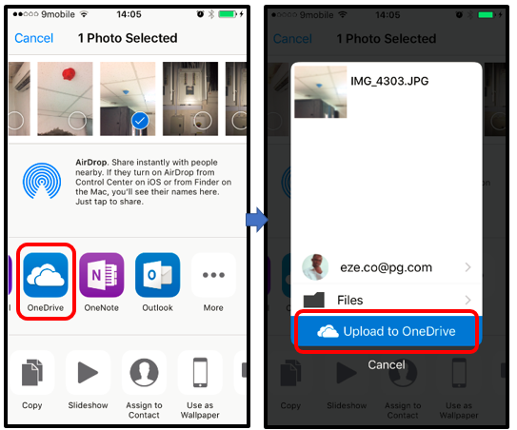
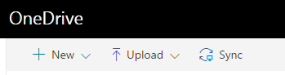
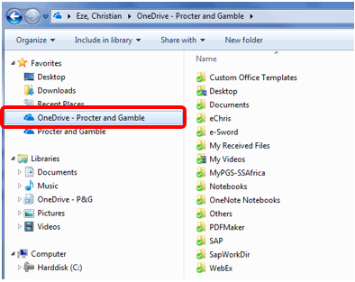
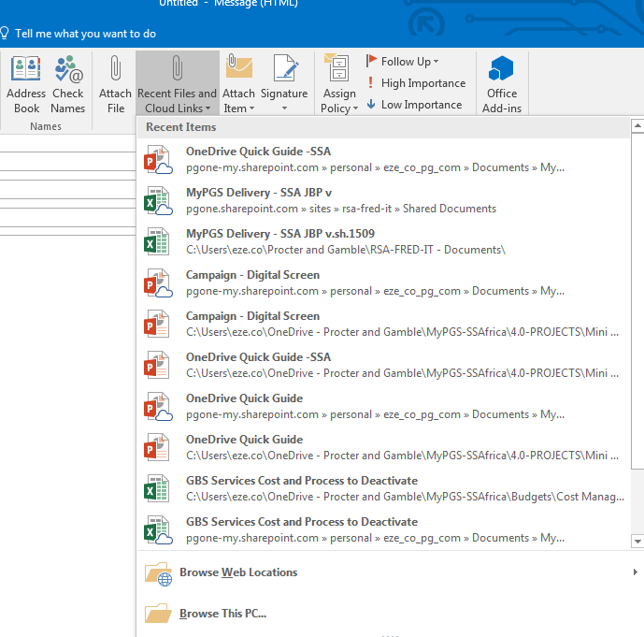
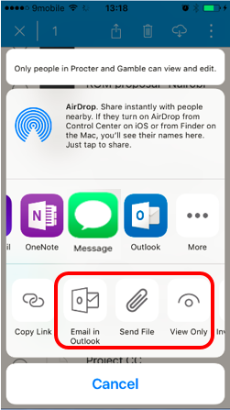
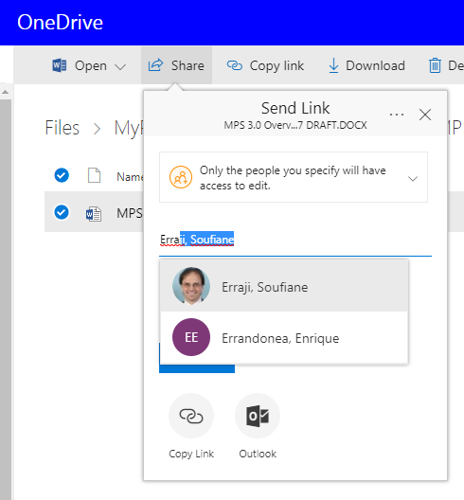

Synchronization Status
#iEmbraceO365Advantage
#iDigitizeMyWork
Sync Error
PRE-REQUISITES
SAVING FILES/FOLDERS
Accessibility of OneDrive
O365 Web Portal
Synchronize folder on PC
Mobile App (iOS and Android)
2. Saving Files/Folder
Saving via O365 Webportal
Save Using PC (on Synchronized folder)
Save using your (corporate/yourmobile) smartphone or corporate iPad
3. Sharing Files/Folders
Share via email (PC)
Share via webportal
Share via Mobile App
Sharing a whole folder via email/webportal/mobile App
Sending Sharing via normal file attachment **
1. Synchronize OneDrive with your PC
2. Sign up for Microsoft Account
(Non-P&G Users Only)
1. Save files using O365 Webportal
2. Save files using your PC
3. Save files using your mobile
Link
Go To (1) Accessibility
ACCESSIBILITY
Go To (2) Saving Files/Folders
Via O365 Webportal: http://portal.office.com
Via Synchronized PC folder:
Via Mobile App:
(iOS and Android)
Go To (3) Sharing Files/Folders
SHARING FILES/FOLDERS
Share files via Email
2. Share files via the web portal
3. Share files via the mobile app

Slide 4
OneDrive Accessibility
1
Back to Main Menu

Slide 5
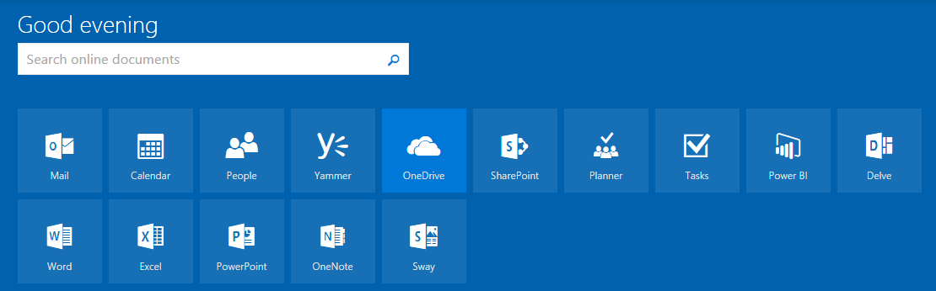
1.1a. Via O365 Web Portal
Go to http://portal.office.com and login using your P&G credentials.
Back to Main Menu

Slide 6
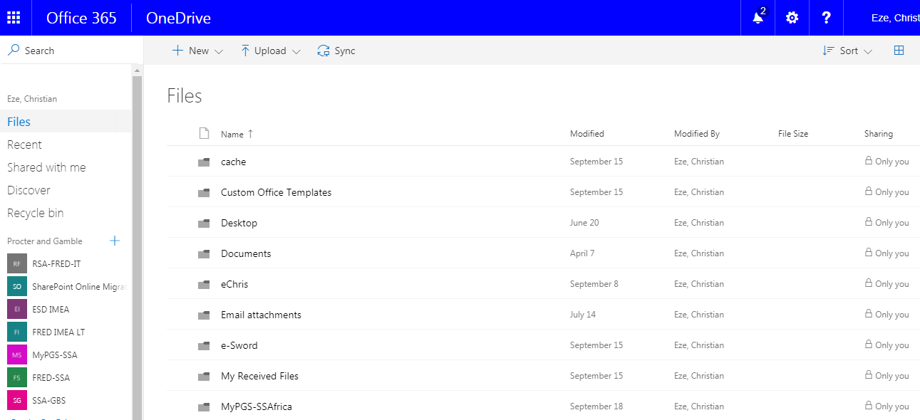
1.1b. Via O365 Web Portal
Click on this button to configure the folder synchronization with your PC.
Click on this to show all the files in your OneDrive.
To save files into your OneDrive, you just have to drag and drop the files here. Or you can always use the upload button.
NB: Internet Explorer allows ONLY Files upload but not folders while Google Chrome allows BOTH Folders and Files upload options
Click on this to show all the files shared with you
Navigate across you Groups’ folders here.
Back to Main Menu

Slide 7
1.2. Via Synchronized PC Folder
After completing the pre-requisite (OneDrive Sync), you are able to access your synchronized folders on your PC. The shortcut is found on your favorites in file explorer
Sync Error
Synchronization status is indicated by symbols on the lower left side of the icons.
Back to Main Menu

Slide 8
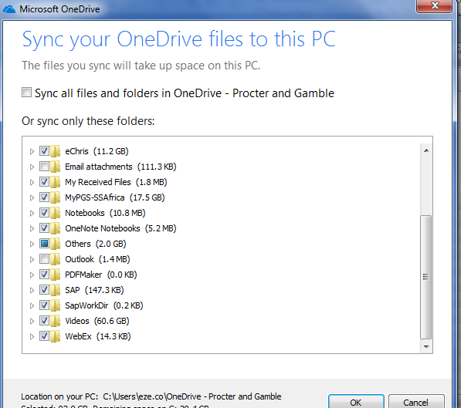
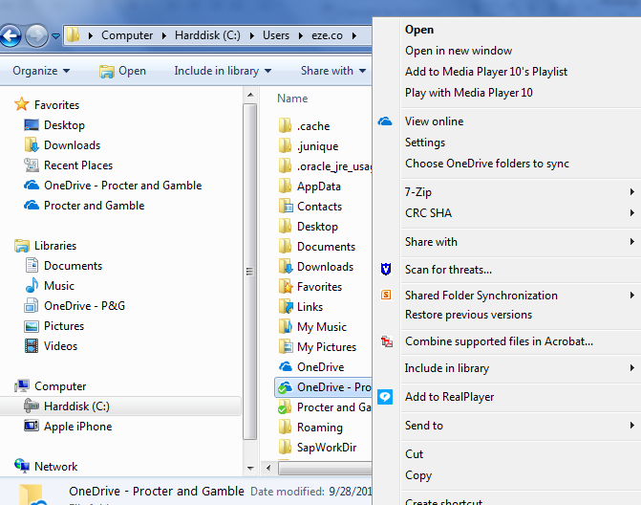
1.2b. Via Synchronized PC Folder
To define which folders need to be synchronized to your PC, Right-click on your OneDrive folder (at the root location as the option may not be available under favourite depending on the root) and select Choose OneDrive Folder to sync.
Select which folders you want to retain in your PC. Uncheck those you want to keep solely in the cloud, then click OK.
Back to Main Menu
NB: you can get the root location of your OneDrive via: Right click on OneDrive folder >Properties > Target (the full address is in the target field)

Slide 9

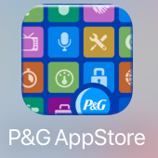

1.3. Via Mobile App
Download OneDrive on your company approved device via the PG app store. The O365 apps can also be downloaded via the Apple App Store and Google Play.
Back to Main Menu

Slide 10
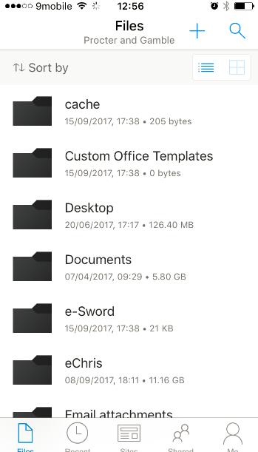
1.3b Via Mobile App
Click this to create a new Office document
Click on search to search for your files
Find your files in the cloud, here:
Click to see files stored in any of the groups you are part of
Click this to see recent files
Click this to check your profile
Back to Main Menu

Slide 11
Saving Files/Folders (3 Options)
2
Back to Main Menu

Slide 12
2.1. Save files using the O365 web portal
To save files into your OneDrive, you can either click on the upload button and select the files you want to upload, or just drag the file/folder you want to upload into the OneDrive body.
NB: Internet Explorer allows ONLY Files upload but not folders while Google Chrome allows BOTH Folders and Files upload options
Back to Main Menu

Slide 13
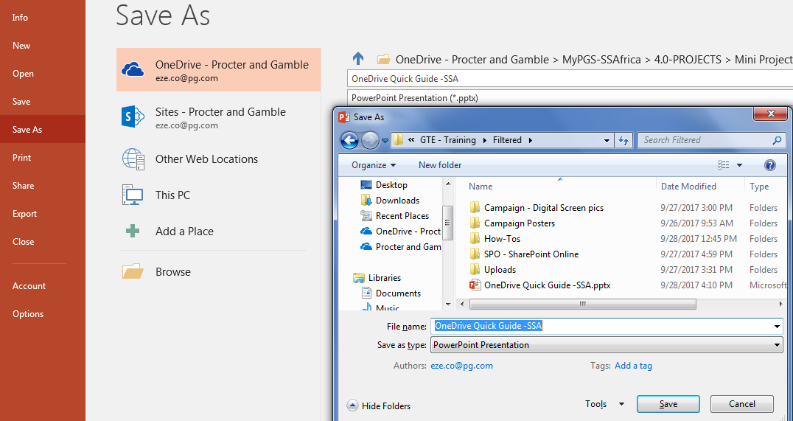
2.2 Save files using your PC
Saving files is as easy as dragging and dropping your files into the OneDrive folder synchronized to your PC! Or copy (if from somewhere) and paste Or
As normal save, from your file > Save >choose either Browse or This PC > OneDrive folder > folder of preference
Sync Error
Synchronization status is indicated by symbols on the lower left side of the icons.
Back to Main Menu

Slide 14
2.3. Save files using the mobile app (iOS)
For any document or photo, click on the arrow icon, select OneDrive, then define which OneDrive folder the file should be saved into.
Back to Main Menu

Slide 15
Sharing Files/Folders (3 Options)
3
You can share files as big as 15GB! The next slides will elaborate on 2 easy ways you can share files.
Back to Main Menu

Slide 16
3.1. Share a file using Outlook
i.e. recipients receiving the OneDrive file link but not the physical file
Files stored in OneDrive can be shared via Outlook email, and permissions will automatically be set for you based on the To: and Cc: fields. This will allow you to share a single version of the file, and all recipients will access the file via OneDrive (instead of receiving an individual copy of the file).
Create a new email message, and click the “Recent Files and Cloud Links” button to see a list of your recently accessed files.
Files with locations starting with pgone-my.sharepoint.com are stored in OneDrive, and you can share those automatically from Outlook. Files starting with “C:\” will simply attach a copy of the file to the message. (Or simply check if the icon has a cloud icon)
If you want to select a OneDrive file that wasn’t recently accessed on your PC, click “Browse Web Locations” and select your OneDrive to browse your files

Slide 17
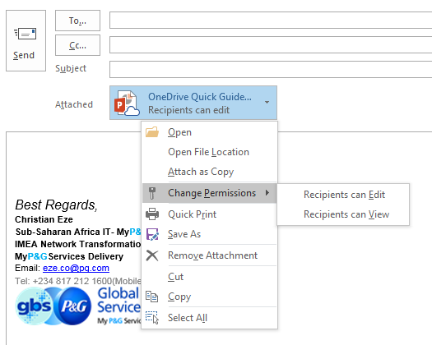
3.1b. Share a file using Outlook
By default, the To: and Cc: recipients get edit access to the file you send. You can change this in the dropdown menu on the file.
Even if you edit the files after sending via email, the recipients will still see the latest version of the file in OneDrive.
NB:
If you are sharing files with users without a P&G email, then the user has to register for a Microsoft Live Account via https://login.live.com/ (Free)
Recipients whose organization are already on Office365 need not register for free MS live account; they will be able to use their office365 account to access the file
NB: The user will have access ONLY to the File Shared not the whole Folder
Back to Main Menu

Slide 18
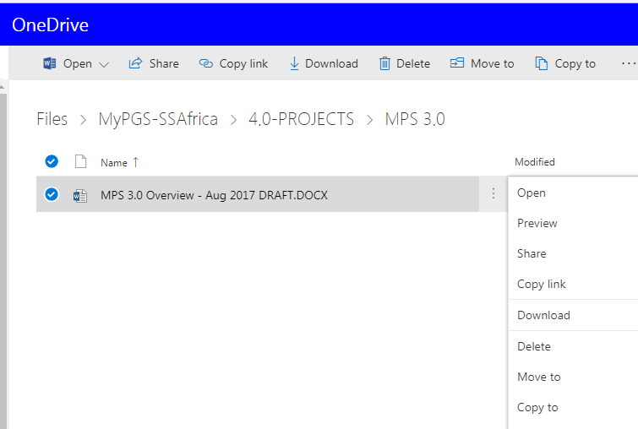
3.2. Share a file via the web portal
From the web view of OneDrive, select the file you want to share, and then select Share.
Alternatively, you can click the ellipsis (…) on a file and select “Share” from the context menu
NB: The user will have access ONLY to the File Shared not the whole Folder
Back to Main Menu

Slide 19
3.2b. Share a file via the web portal
In the Share window, type the name of each person you want to share the file with. As you type each name, suggestions appear that match your contacts. When you see the name you want, select it to add it to the invitation list.
Select the permission in the list that you want to grant people. You can change the permission later for any person.
Click Share.
Back to Main Menu

Slide 20
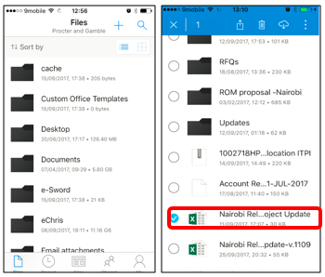
3.3. Share a file via the mobile app
STEP 1:
Open the file you want to send, using the OneDrive app or select the file by click-holding the file for some seconds
STEP 2:
Click on the arrow button to display the selection menu. You have 3 options:
Email in Outlook- Automatically pastes the file edit/view link into a new email.
Send File- Click on the Email in Outlook button after selecting this. This attaches the actual file into a new email.
View Only- Automatically pastes the file view only link into a new email.
NB: The user will have access ONLY to the File Shared not the whole Folder
Back to Main Menu

Slide 21
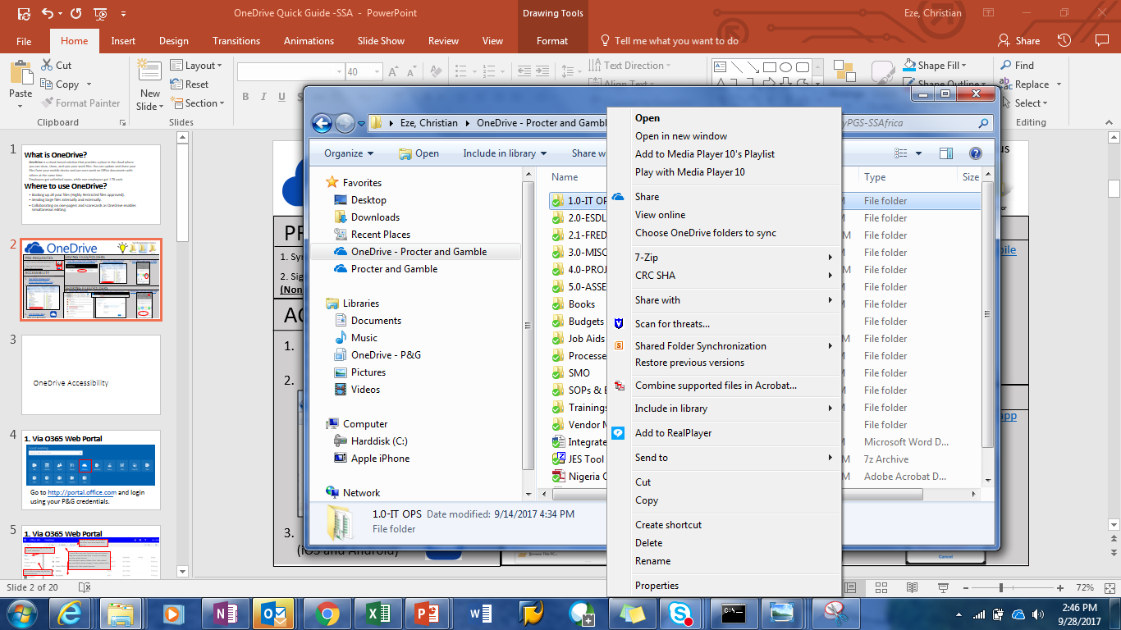
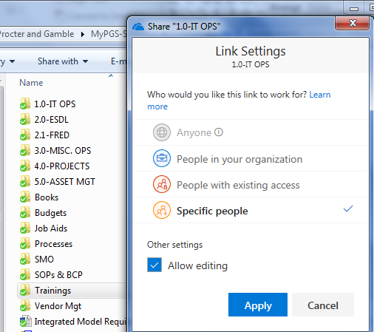
3.4. Share a Folder (on your personal OneDrive not O365 Team/Group)
On your PC, navigate to OneDrive folder and then to the Folder to Share.
Right click on the File and click on Share
Alternatively, you can click the ellipsis (…) on a file and select “Share” from the context menu
Select the option of people to share it with, say, specific persons and enter their email addresses and enter their permission level (view/edit)
Click on Apply
The recipients will get the email with a link and will have access to the whole folder shared
NB: The user will have access to the WHOLE FOLDER Shared not the whole only a file
Back to Main Menu

Slide 22
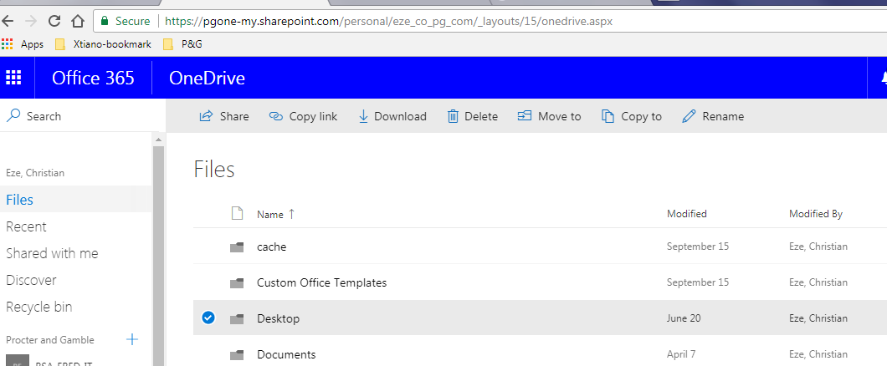
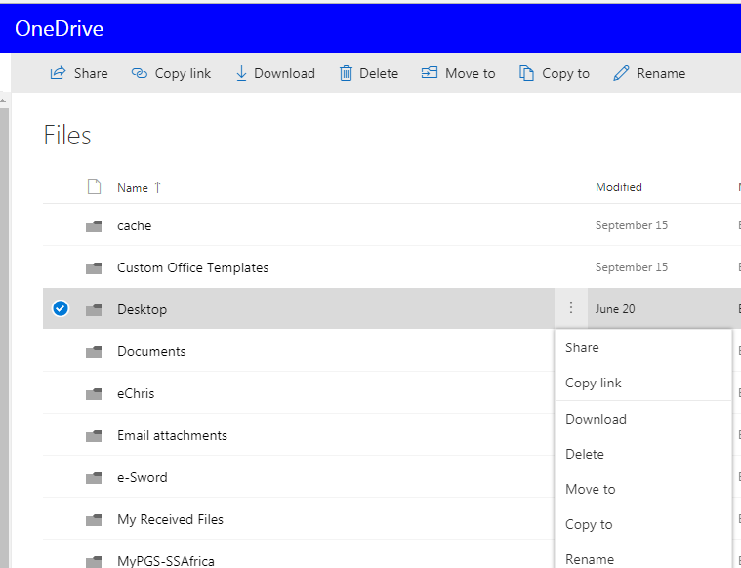
3.4b Share a Folder via the Web
(on your personal OneDrive not O365 Team/Group)
On the web, navigate to OneDrive folder and then to the Folder to Share.
Select the folder and click on Share
Alternatively, you can click the ellipsis (…) on a folder, towards folder name column end (see 2nd screenshot) and select “Share” from the context menu
Select the option of people to share it with, say, specific persons and enter their email addresses and enter their permission level (view/edit)
Click on Apply
The recipients will get the email with a link and will have access to the whole folder shared
NB: The user will have access to the WHOLE FOLDER Shared not the whole only a file
Back to Main Menu

Slide 23
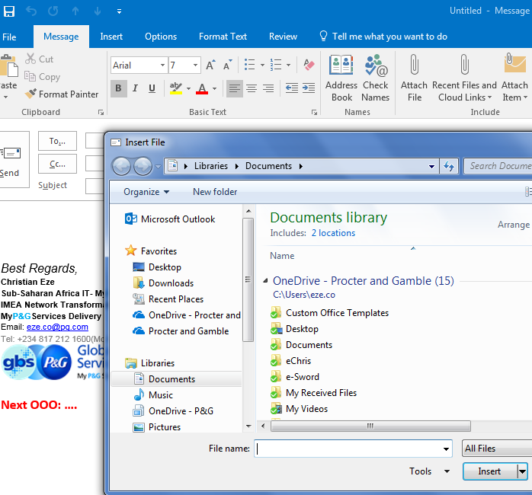
3.5. Want to Share Send a COPY of the file via Outlook**
via “Attach Files” Menu > navigate to OneDrive Folder; i.e. having each user get a copy of the file just like normal attachment
This is the normal file attachment sharing via email where each recipient gets a copy of the file.
Create a new email message, and click the “Attach Files” button to navigate to the OneDrive Folder on your PC
Select your OneDrive Folder and browse your files
**NB: This is not file sharing.
It is just sending a copy of the file as normal attachment as we do before.
The user will have the copy and will not navigate to O365 to open it or get it.
Nothing new; why it called out here? Just a reminder that your synchronized folder is one of the folders on your PC you can go to and get a file
Back to Main Menu

Slide 24
For Additional References:
OneDrive Mobile App
https://support.office.com/en-us/article/Use-OneDrive-on-iOS-08d5c5b2-ccc6-40eb-a244-fe3597a3c247
OneDrive PC
https://support.office.com/en-us/article/OneDrive-training-1f608184-b7e6-43ca-8753-2ff679203132?ui=en-US&rs=en-US&ad=US#ID0ECBAAA=OneDrive_for_Business
Login to Office365 or any of the online tools
You can use any of the following options to login to the cloud for any of the tools:
With one login you can access all other tools
Onedrive.com
Yammer.com
Office.com
Outlook.office365.com
login.microsoftonline.com
Back to Main Menu

